Slide 1
Introduction to RxJS
- Tharuka Vihswajith -
Notes:
Heard
Used
Ng 2 or higher
observarble

Slide 2
What is Asynchronous programming
Parallel programming in which a unit of work runs separately from the main application thread
Notifies the calling thread of its completion, failure or progress.
Notes:
Synchronous – executing line by line
Asynchronous - Without waiting put to an another thread

Slide 3
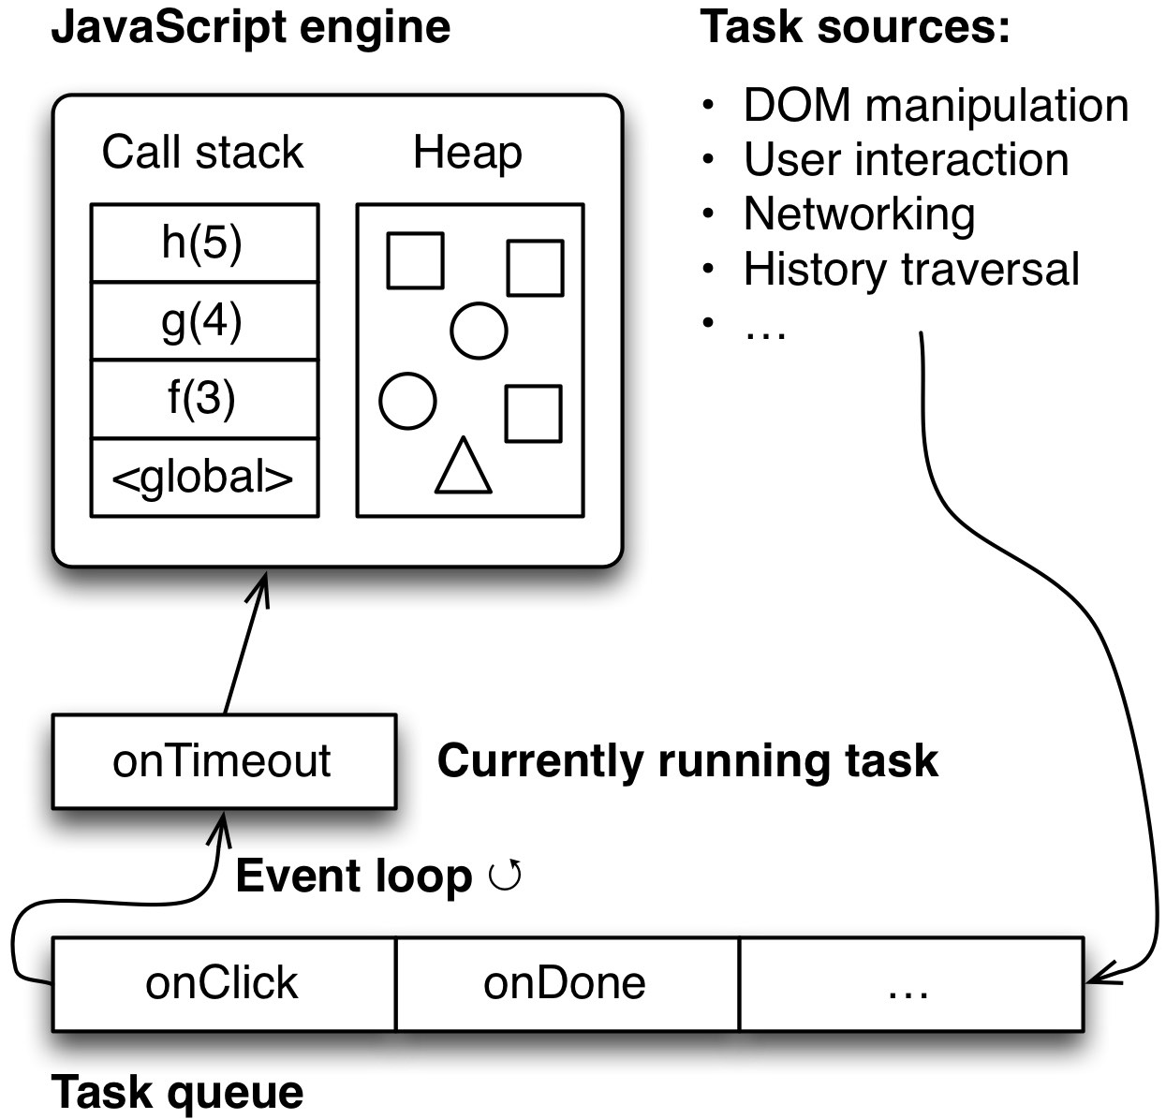
JavaScript and Event Loop
http://rauschma.github.io/async-examples/blocking.html
Notes:
Task queue manages priority of tasks
Every normal browser has a js engine
Push setTimeout

Slide 4
Web Workers
Workers really are multi-threaded.
JavaScript is a language, it doesn't define a threading model, it's not necessarily single threaded
Most browsers have historically been single threaded (though that is changing rapidly: IE, Chrome, Firefox), and most JavaScript implementations occur in browsers
Web Workers are not part of JavaScript, they are a browser feature which can be accessed through JavaScript

Slide 5
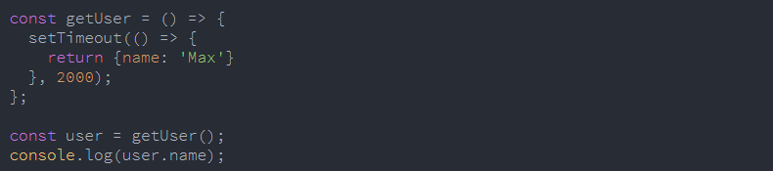
Will this works?
Let’s start…
https://academind.com/learn/javascript/callbacks-vs-promises-vs-rxjs-vs-async-awaits/
https://codepen.io/anon/pen/KoaPqO?editors=1010
Notes:
Promise really a great solution if you want to handle asynchronous operations which don't end after one "value".

Slide 6

How to Install it
http://reactivex.io/rxjs/
Notes:
Remove @version and we can give any version like @5.5.7
https://jsfiddle.net/L4njqpps/8/

Slide 7
Key things
Observables
Observer
Subscribe
Operators

Slide 8
Observable
A set of value over time
On subscription, ties and observer to a producer of value
On completion or unsubscription, execute tear down
Simply
Observable is a Wrapper around some data source
Notes:
Data source – Stream of values
After u use it unsubscribe
Memory leak

Slide 9
Observables are sets
Operators
Operators transform sets into new sets
Notes:
After u use it unsubscribe
Memory leak

Slide 10
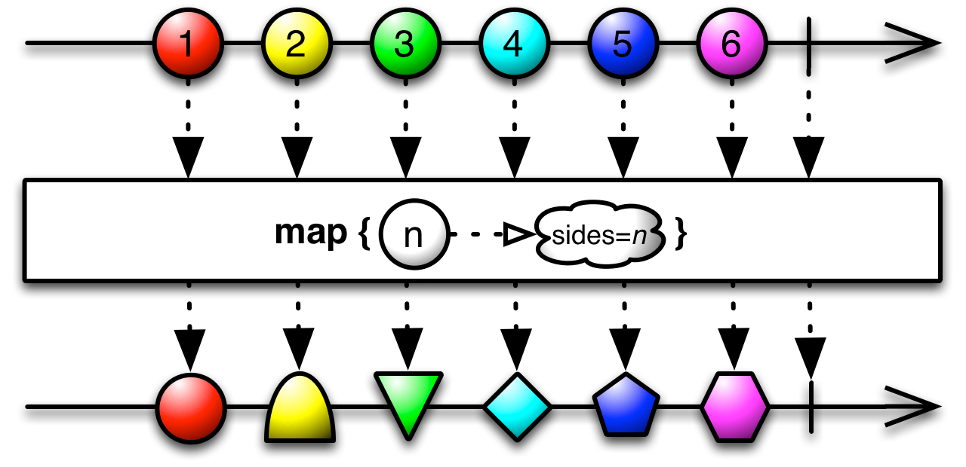
OPERATORS LIKE map() OR throttleTime()
https://jsfiddle.net/wo6yrhta/

Slide 11
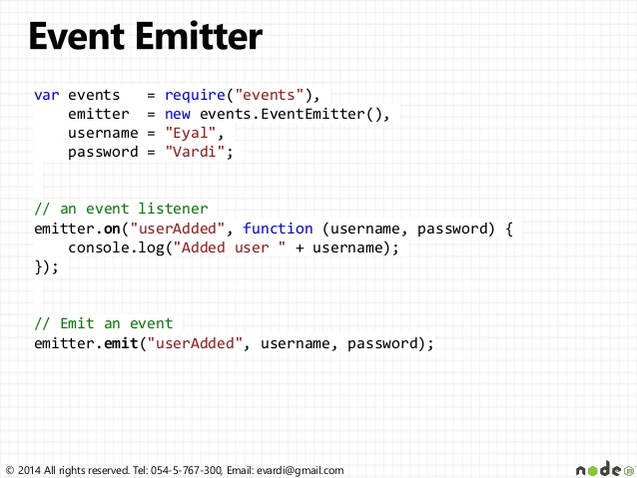
Subject ( ~EventEmitter )
https://jsfiddle.net/zjprsm16/
Notes:
Observable – passive
Only listning

Slide 12
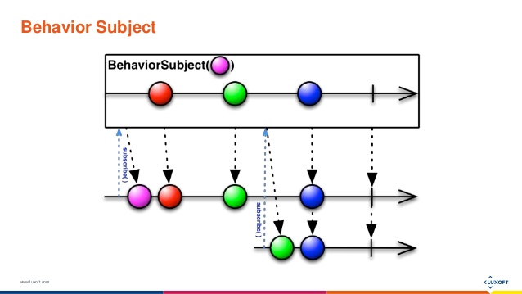
Behavior Subject
https://jsfiddle.net/fe027k0c/

Slide 13
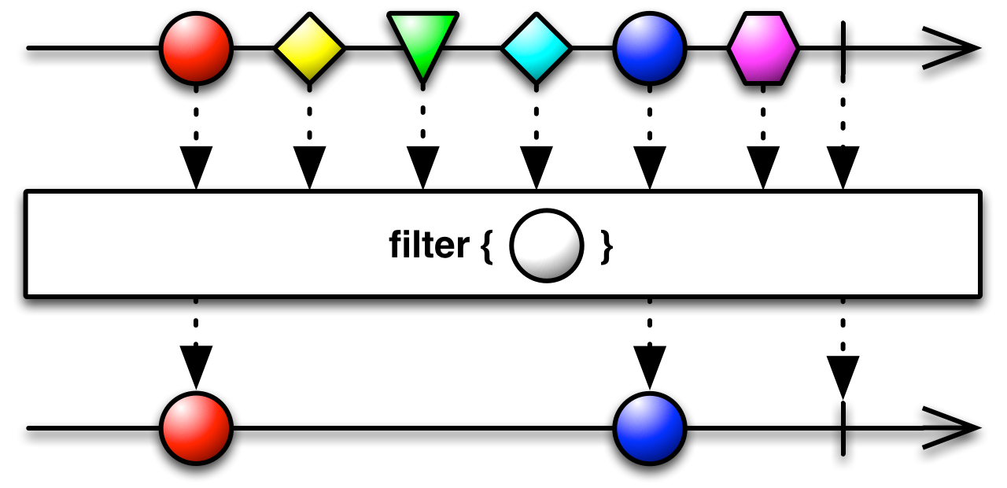
filter() Operator
https://jsfiddle.net/eox8x5s6/

Slide 14
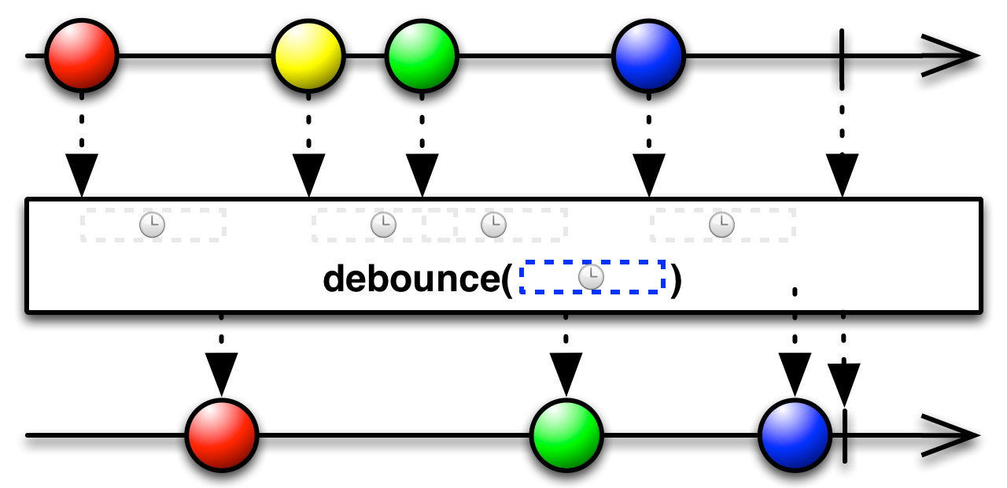
debounceTime & distinctUntilChanged
https://jsfiddle.net/chuuueL1/125/
https://jsfiddle.net/chuuueL1/126/

Slide 15
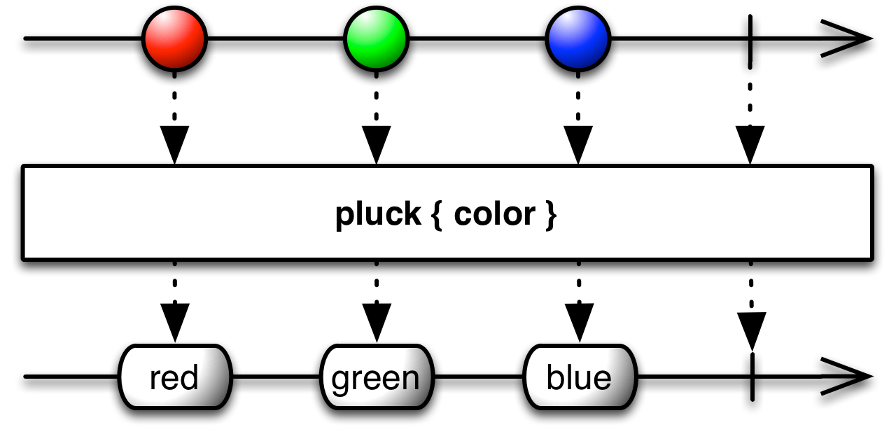
pluck() Operator
https://jsfiddle.net/1t8fyqtw/

Slide 16
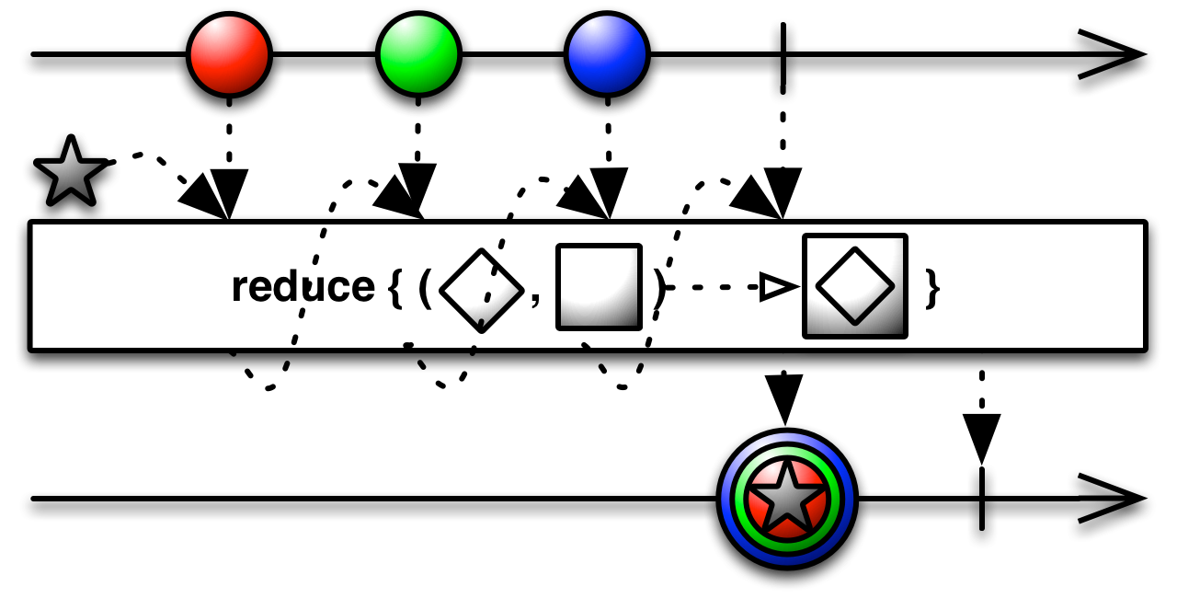
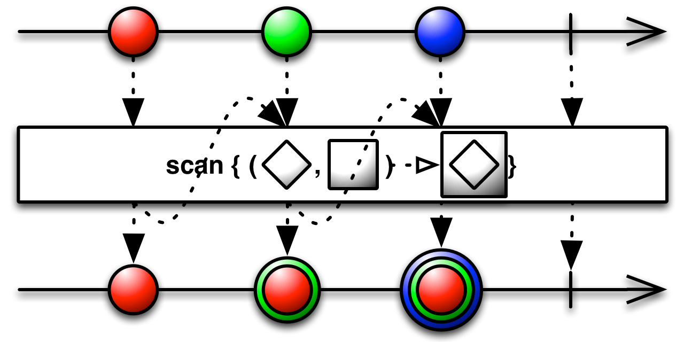
scan() vs reduce()
https://jsfiddle.net/yu9efkhp/

Slide 17
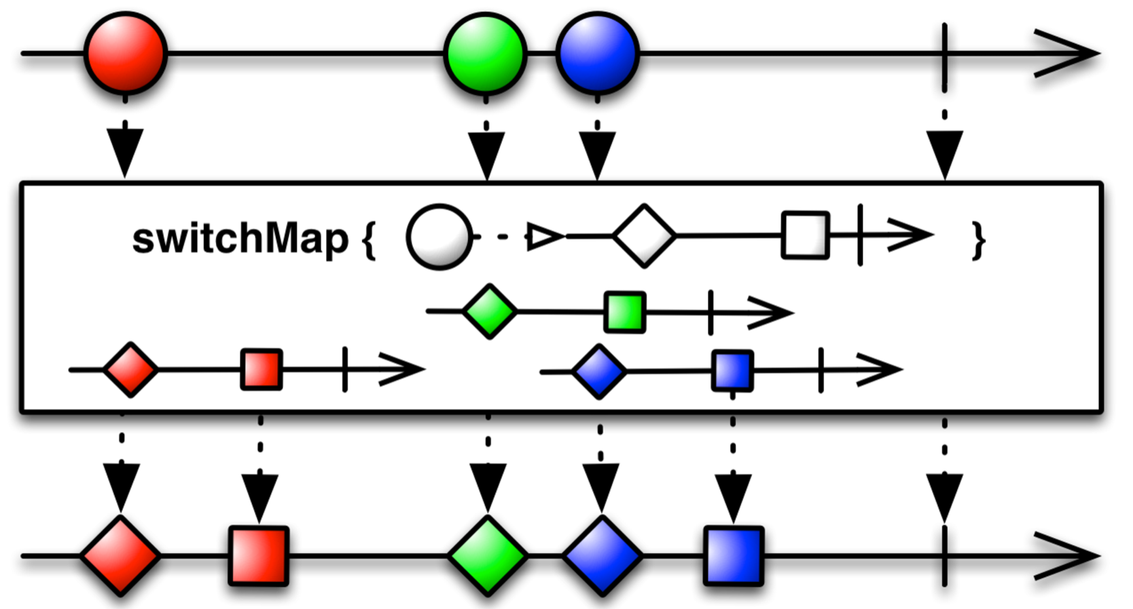
switchMap() Operator
https://jsfiddle.net/1w6k5sdj/

Slide 18
Resources
https://rxviz.com/examples/pause-and-resume
https://css-tricks.com/animated-intro-rxjs/
https://www.slideshare.net/benlesh1/advanced-rxjs-animations

Slide 19
Let’s move to Demo

